Slide 1

GNSS_R SYSTEM
Presented by Erick Tchitae

Slide 2

Summary
01
Introduction
02
Literature review
03
System Architecture
04
Integration of the Mobile and Static Units
05
Result
06
Conclusion
1

Slide 3

INTRODUCTION
2

Slide 4
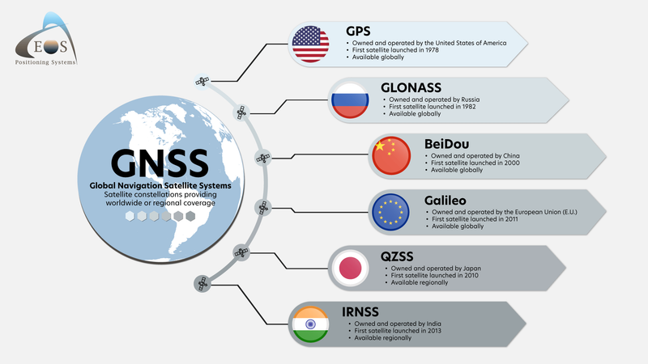
3

Slide 5


USERS
4

Slide 6
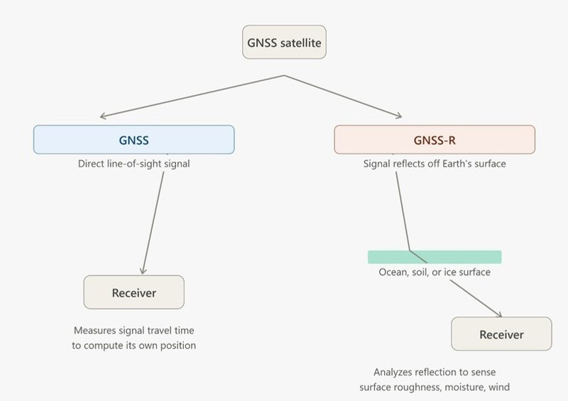
GNSS # GNSS_R
5

Slide 7
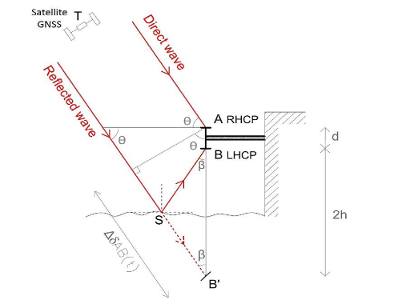
Literature review
6

Slide 8

SYSTEM
ARCHITECTURE
7

Slide 9
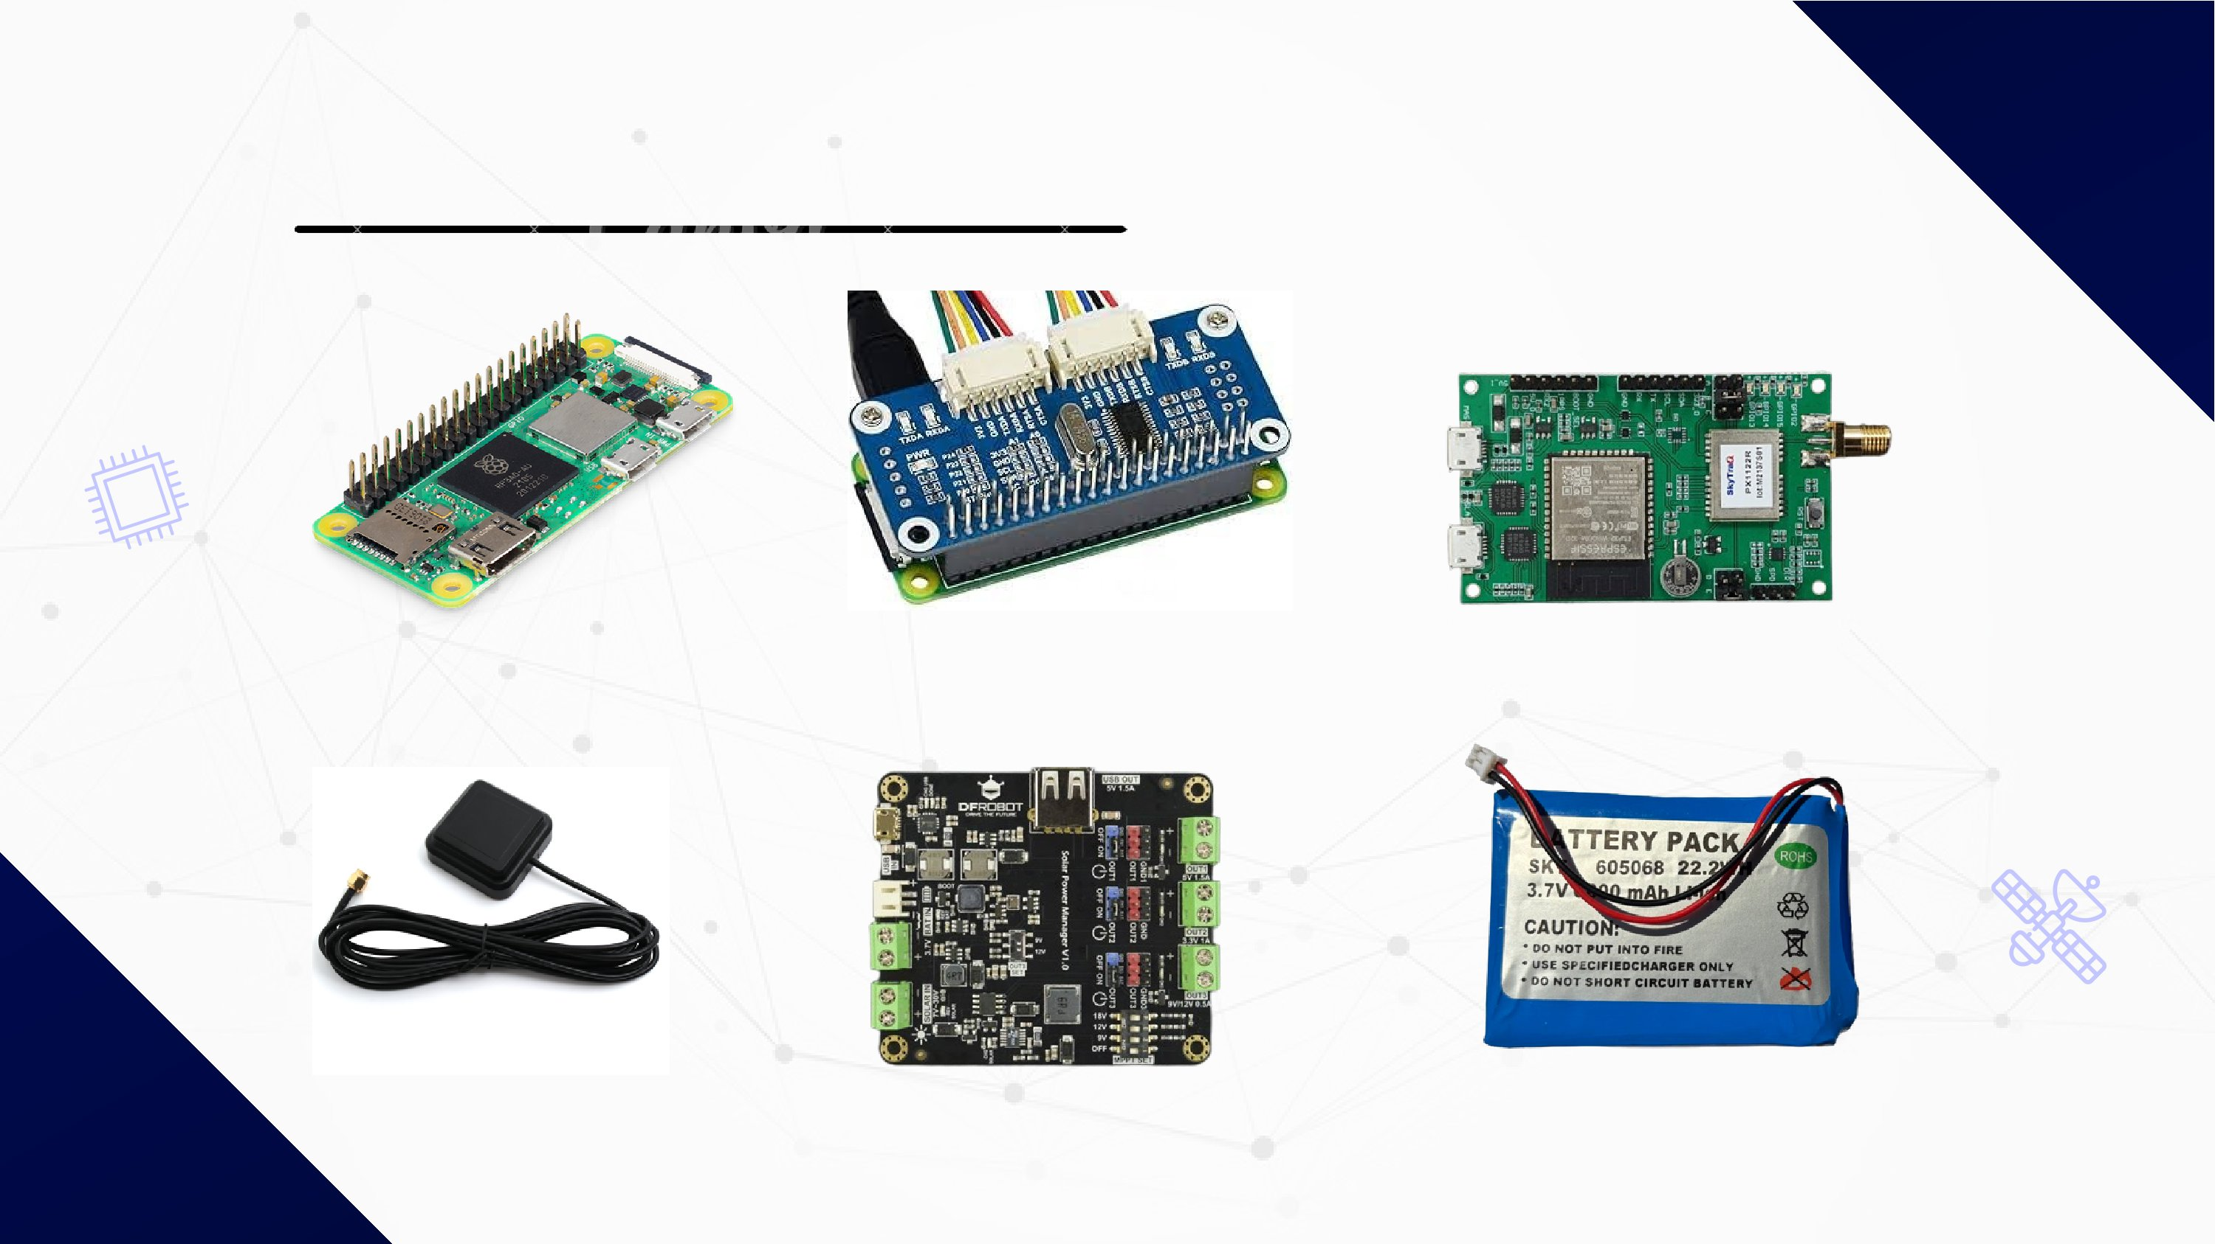
HARDWARE
Raspberrz PI Zéro 2W
Serial Hat
PX1122_R RECEIVER
Atenna
voltage converter
PI LI-ion Battery
8

Slide 10
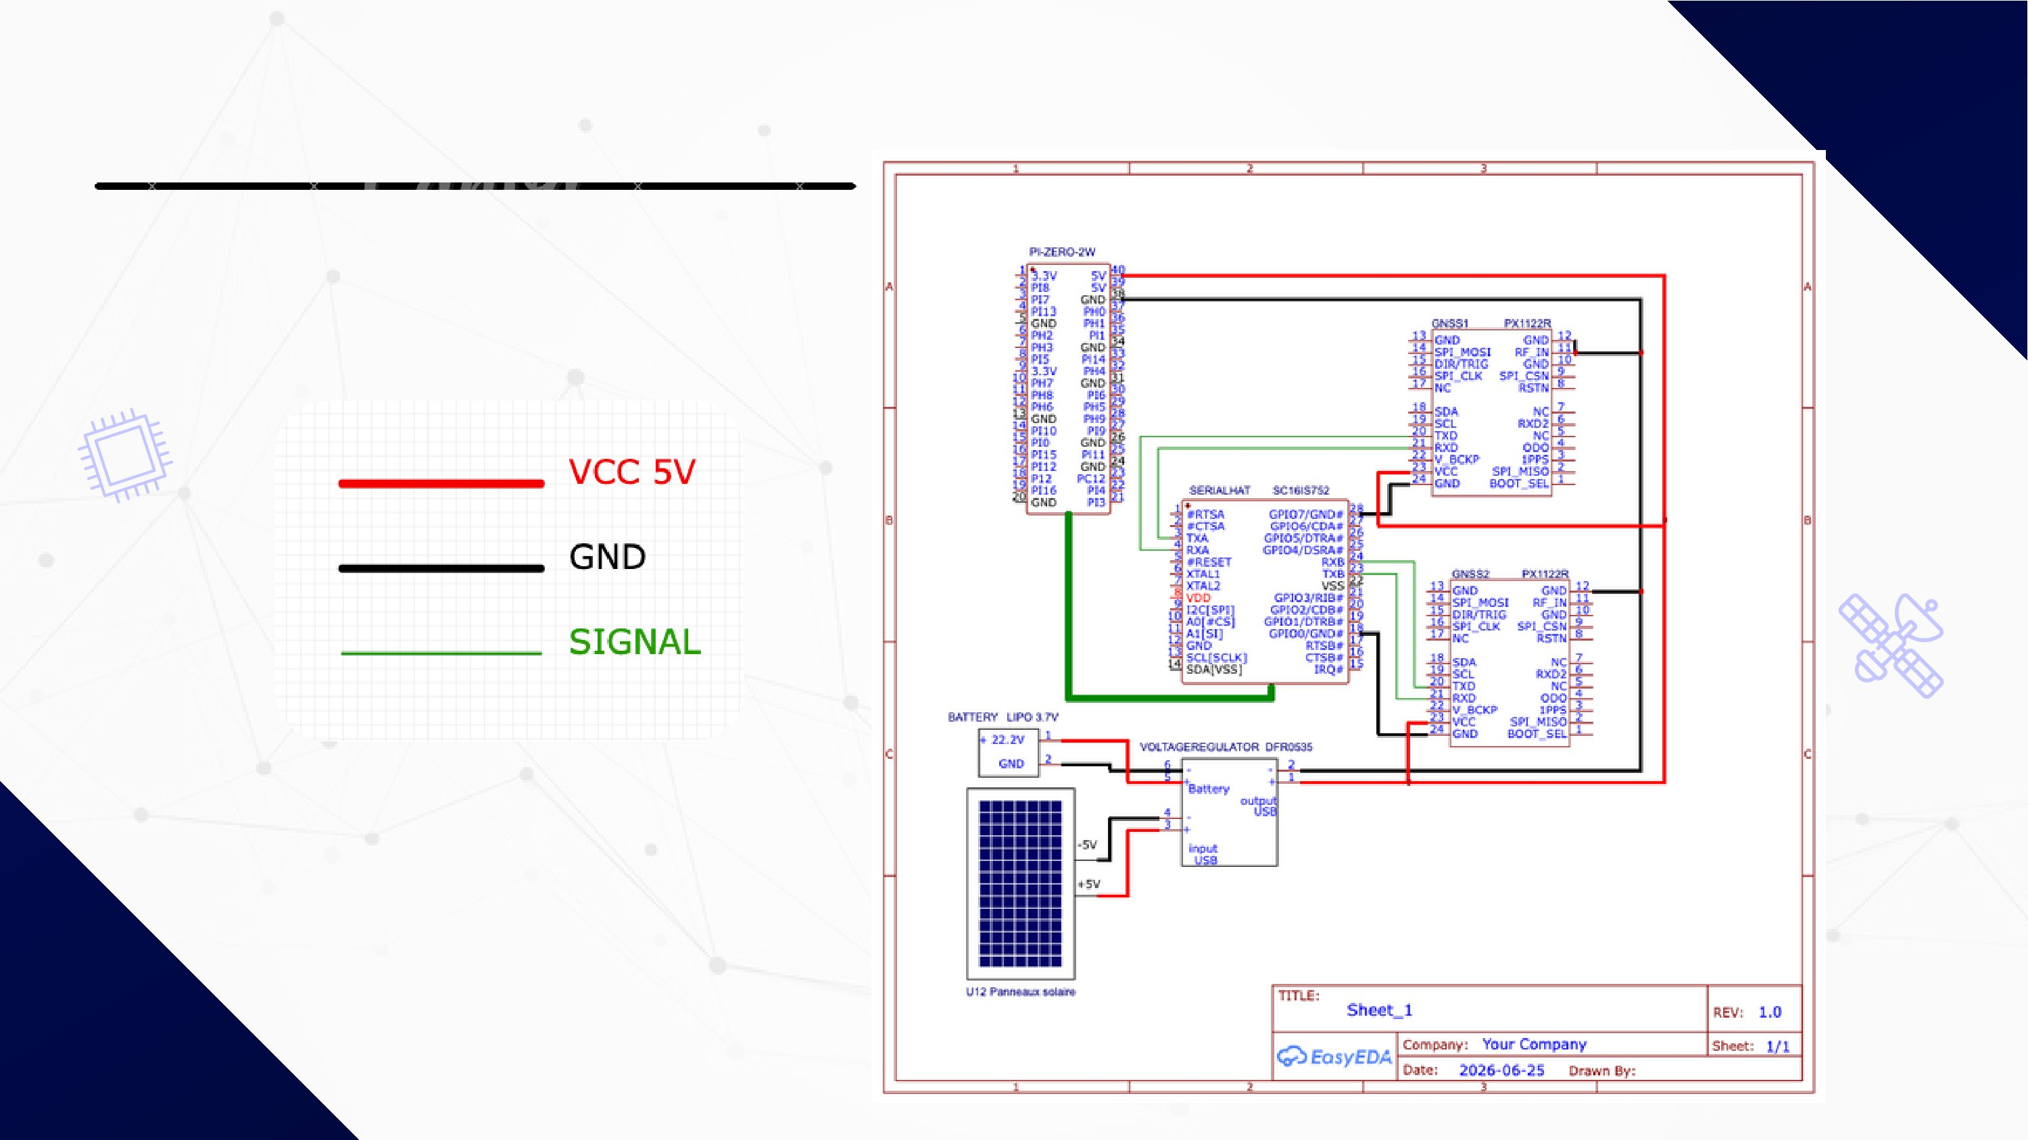
System schematic
9

Slide 11

SOFTWARE
START
Open GNSS1 and GNSS2 serial ports
WHILE (no stop requested):
Create new timestamped .bin files (GNSS1 + GNSS2)
WHILE (segment duration not elapsed):
Read GNSS1 data -> write to .bin file
Read GNSS2 data -> write to .bin file
Close the .bin files
[Background thread] Convert .bin -> .obs + .nav (RINEX)
Save locally
10
Close serial ports
END

Slide 12

RESULT
11

Slide 13
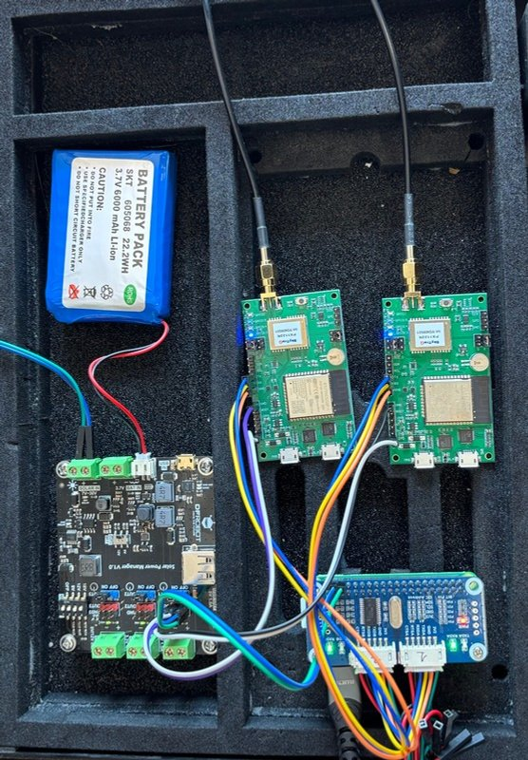
12

Slide 14
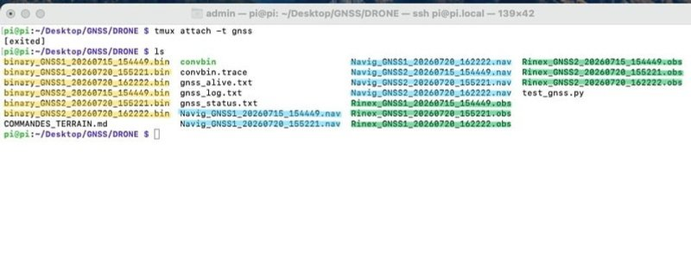
13

Slide 15
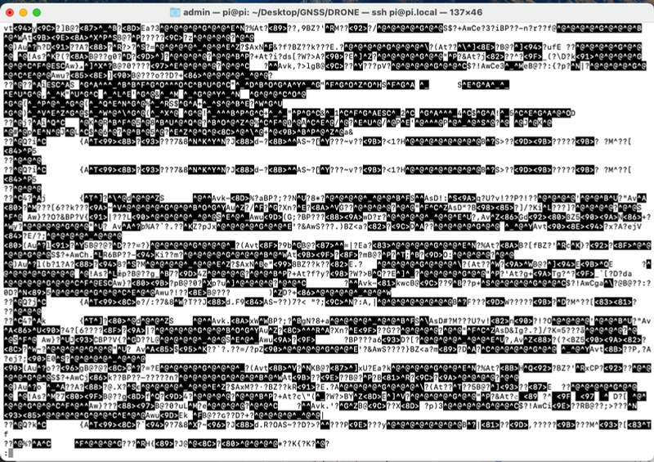
14

Slide 16
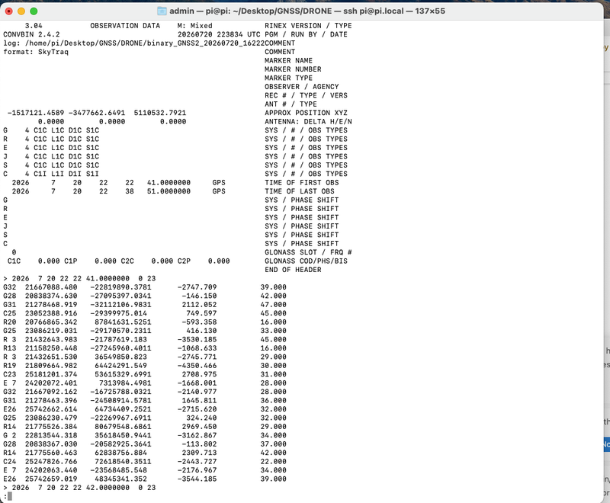
15

Slide 17
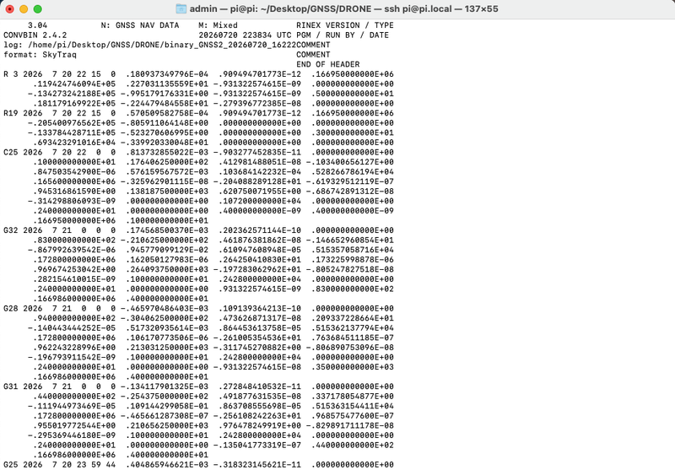
16

Slide 18

INTEGRATION OF THE SYSTEM
17

Slide 19
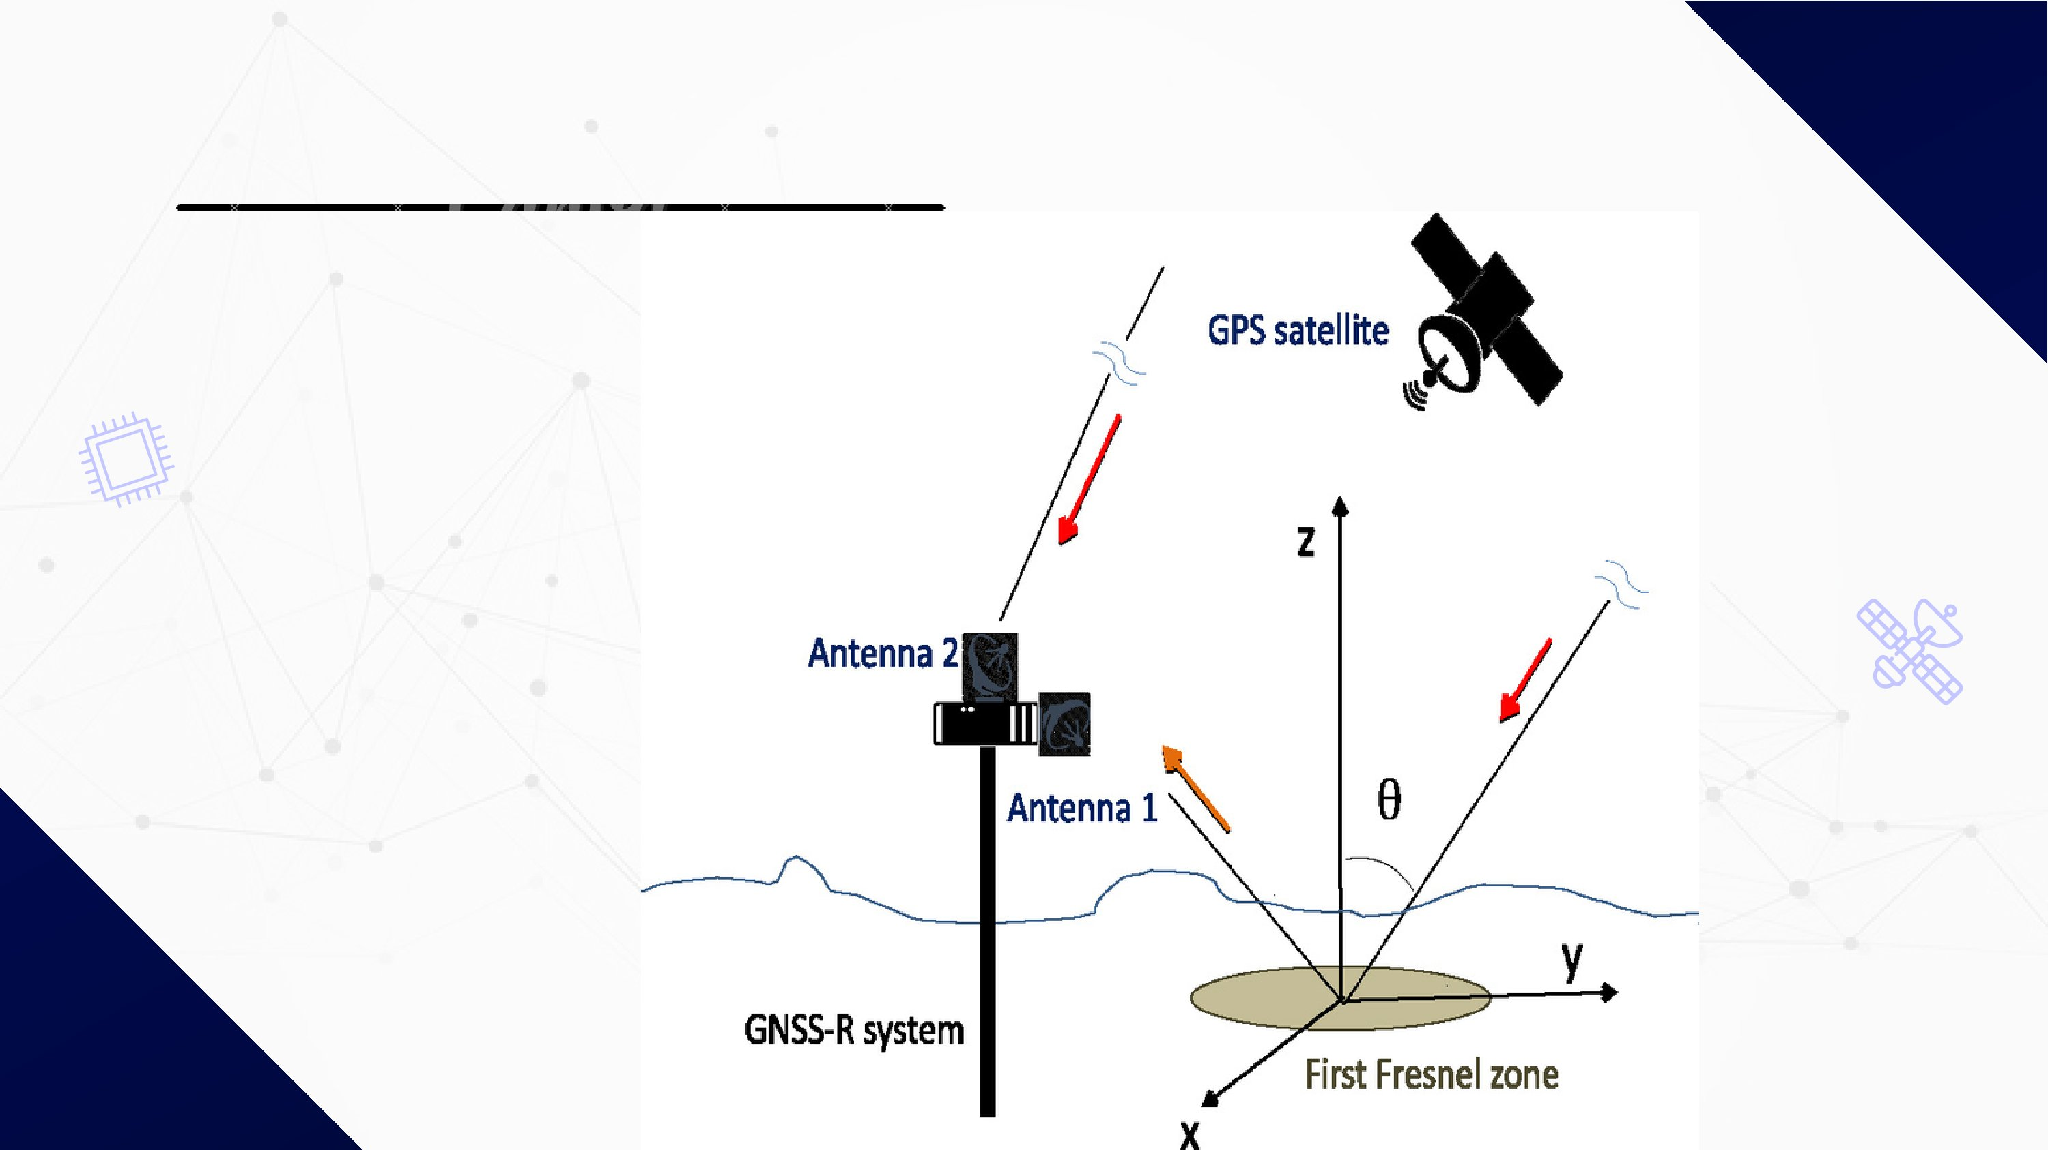
STATIC
18

Slide 20
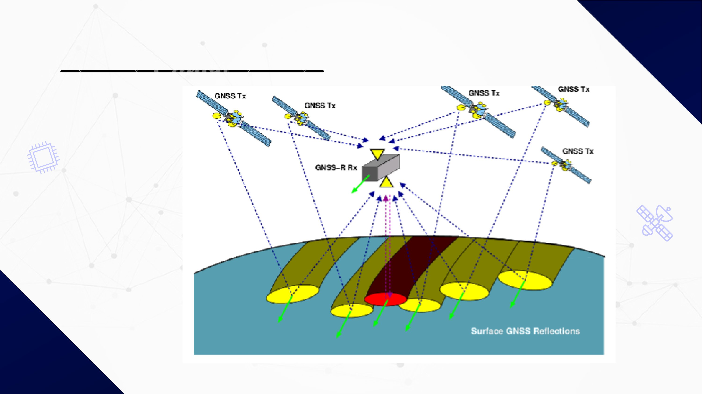
MOBILE
19

Slide 21

CONCLUSION
20

Slide 22

21

